Slide 1
CUSTOMER RETENTION PROJECT
Submitted by
Khanin Deka

Slide 2
PROBLEM STATEMENT Understand and analyze the various factors that affect the success of online store.

Slide 3
Data source and format 1. The data is collected from Indian online shoppers. 2. The dataset contains 269 rows and 71 columns. 3. All the columns are of categorical data-type.

Slide 4
DATA PREPROCESSING: 1. strip() function was used to get rid of escape characters in the names of the columns. 2. The 7th column had two unique values of 'Mobile Internet' and 'Mobile internet'. One of them is replaced with the other with the help of replace() function. 3. In column 48 to 71 the respondents may choose one or more among the 5 e-commerce sites. Data in this format can’t be visualized. Hence we made a new dataframe which contains the count (of each of the 5 e-commerce sites) of being chosen by the respondents for each query(column). This is done mainly for visualization purpose.

Slide 5
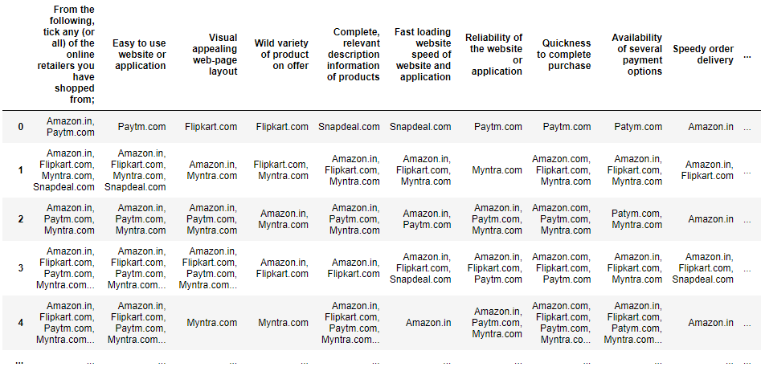
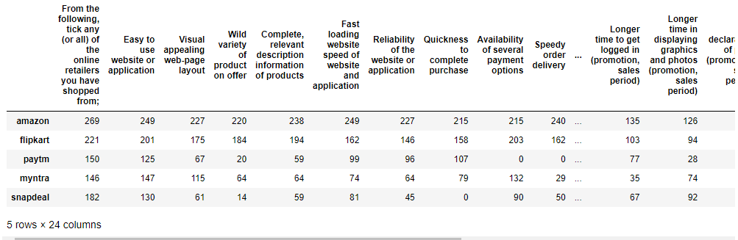
Before
After

Slide 6
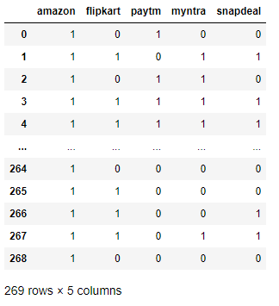
4. For columns 48-71 a function is used to make separate columns for each of the 5 e-commerce sites which captures the data of whether an e-commerce site is chosen by the respondent or not. 1 denotes chosen and 0 denotes not chosen. The function takes a column name as input and returns a dataframe with encoded values for that column.

Slide 7
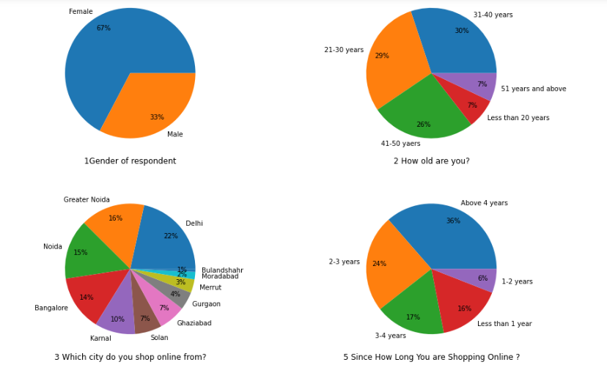
VISUALIZATION & OBSERVATIONS At first let’s see some plots to know about the respondents.

Slide 8
Observations: 1.Majority of respondents are female. 2.85% of the respondents belong to 21-50 years age category. 3.A high majority(84%) of the respondents have been shopping online since at least 1 year. 4.Majority of respondents are from tier-1 cities.

Slide 9
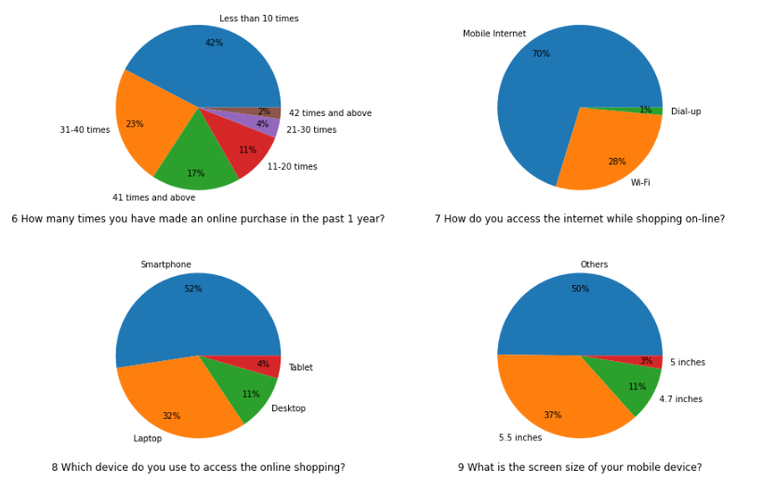
Observations:
42% of the respondents have purchased online at least 30 times in the past 1 year. 42% have purchased less than 10 times.
70% of the respondents use mobile internet connection.
More than half the respondents use smart-phone to do online purchasing.

Slide 10
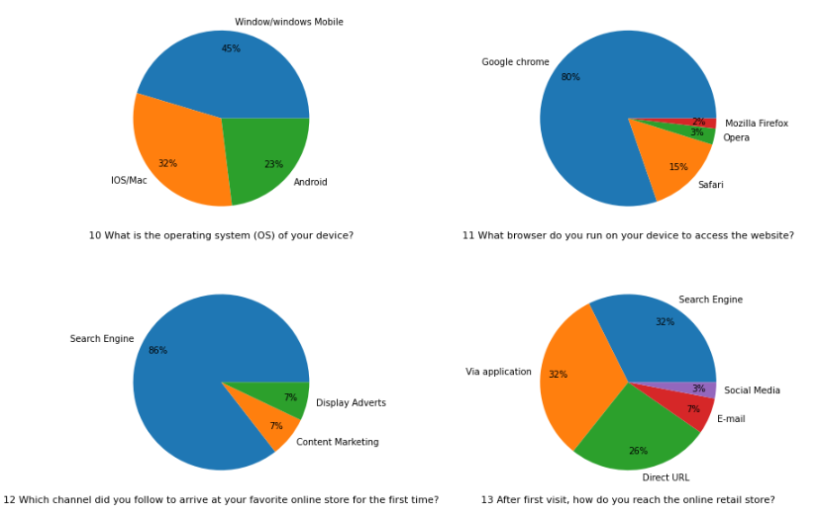
Observations:
Majority of the respondents use windows operating system.
Google Chrome is the most preferred browser(80%)
Use of search engine is highest(86%) to arrive at the e-commerce site for the first time.

Slide 11
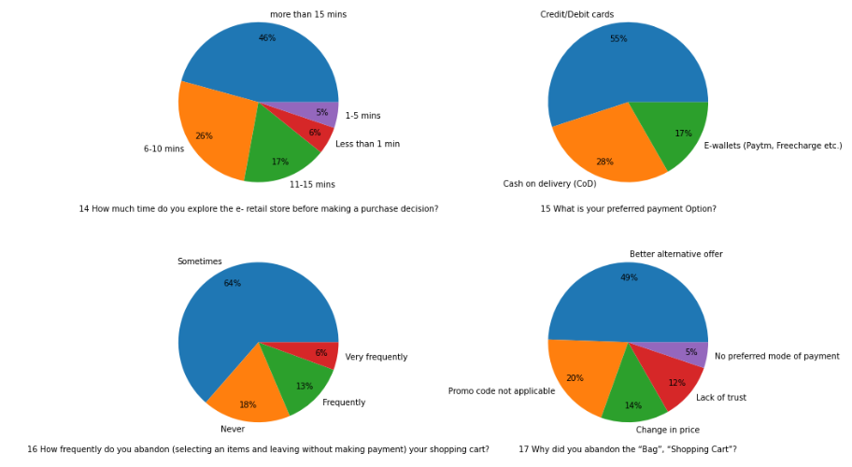
Observations:
Almost 9 out of 10 people explore the e-commerce site for at least 6 minutes before making a purchase.
More than 50% people prefer credit/debit cards for payment.
Almost half the respondents think that they get better alternative offer and hence abandon the shopping cart.

Slide 12
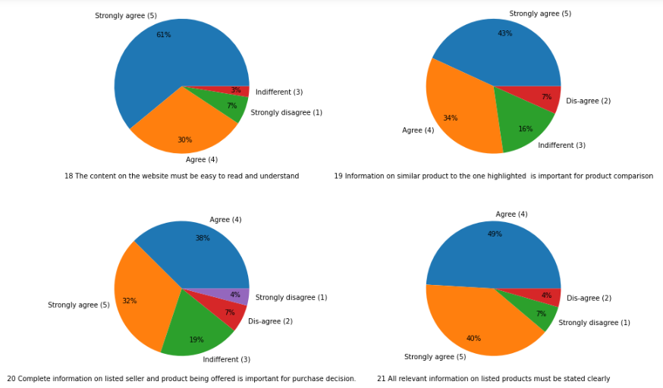
Now let's analyze customer's viewpoint on various parameters of e-commerce using pie-plots.

Slide 13
Observations: 1.More than 90% of the respondents agree that the content on the site must be easy to read and understand. 2.More than 75% agree that similar product comparison is important. 3.70% of the respondents think that it is important to mention seller's information. 4. Almost 90% of the respondents think that product's relevant information should be stated clearly.

Slide 14
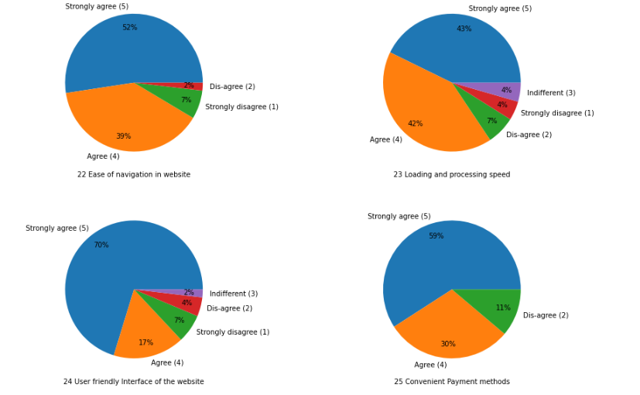
Observations:
Ease of website navigation is important according to more than 90% of the respondents.
85% of the respondents think that loading and processing speed is important.
More than 85% agree that the user friendliness of the website is important.
Almost 90% of the people think that convenient payment methods is important.

Slide 15
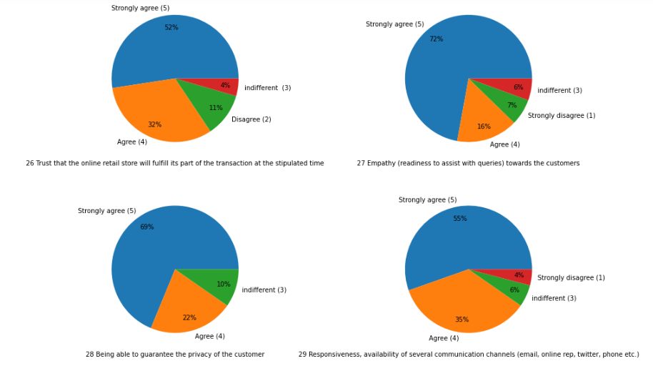
Observations:
Almost 90% of the respondents believe that responsiveness with query and availability of multiple channels to communicate is important.
More than 90% of the respondents believe that privacy policy is an important factor.

Slide 16
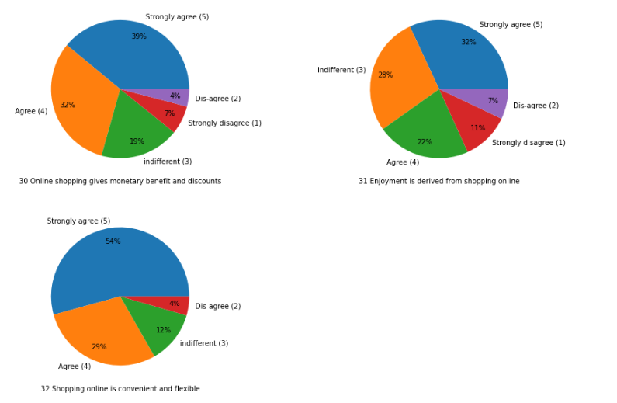
Observations:
More than 70% of the respondents believe that online shopping gives monetary benefits and discounts.
More than half the people consider online shopping enjoyable.
More than 80% of the people think that online shopping is convenient and flexible.

Slide 17
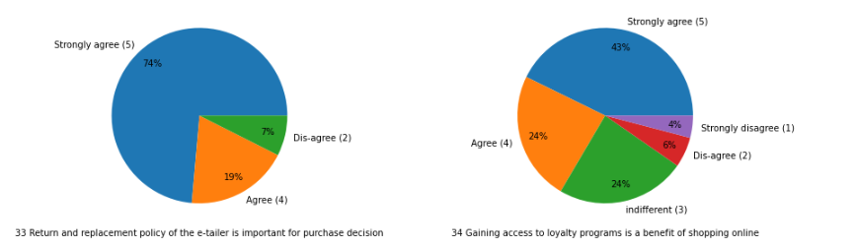
Observations:
More than 90% of the respondents believe that return or replacement policy is important in purchase decisions.
Two-third of the respondents believe that loyalty programs is one of the benefits of online shopping online.

Slide 18
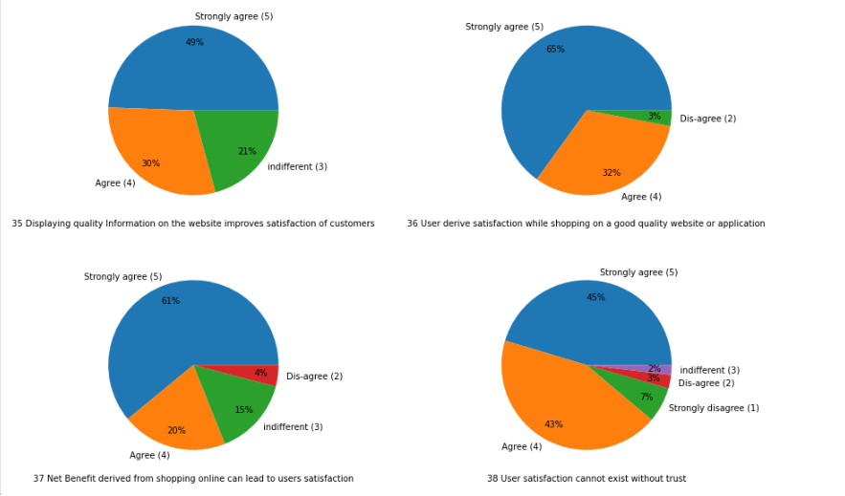
Observations:
Almost 80% of the respondents believe that quality information is important for customer satisfaction.
More than 90% people believe that quality of website/application is important for customer satisfaction.
More than 80% respondents believe that net benefit is important for customer satisfaction.
A very high majority(88%) of people think that without trust a customer satisfaction can't exist.

Slide 19
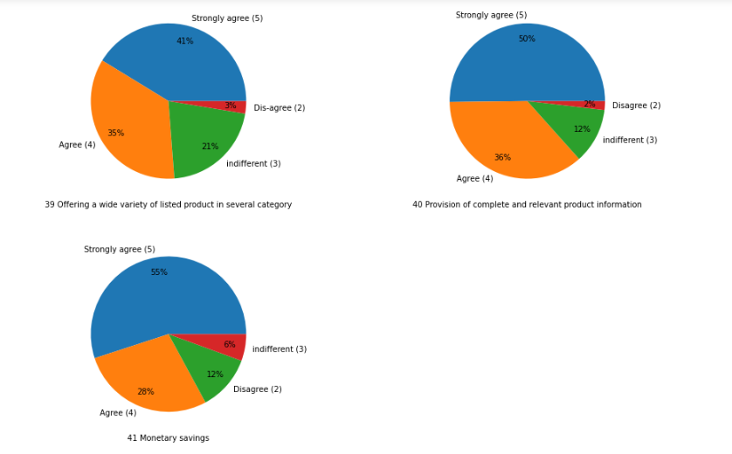
Observations:
More than 75% of the respondents believe that online shopping offers a wide variety of products in several category.
More than 80% of the respondents believe that online shopping help in monetary savings.

Slide 20
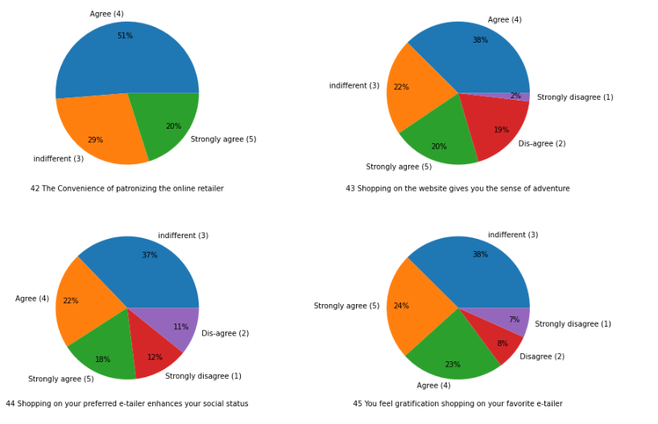
Observations:
More than 70% of the respondents believe that patronizing online retailers is convenient.
More than half the respondents consider that online shopping gives them a sense of adventure.
40% of the respondents believe that purchases from their preferred e-retailer enhances their social status.
47% of the respondents feel gratification by shopping from their favorite e-commerce website.

Slide 21
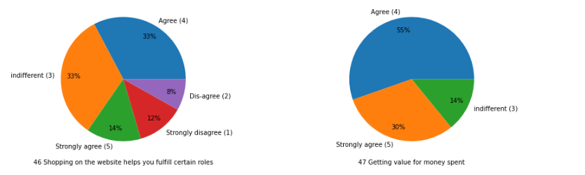
Observations:
47% of the respondents believe that online shopping helps them fulfill certain roles.
A high majority(85%) believes that online shopping helps them get value for their money.

Slide 22
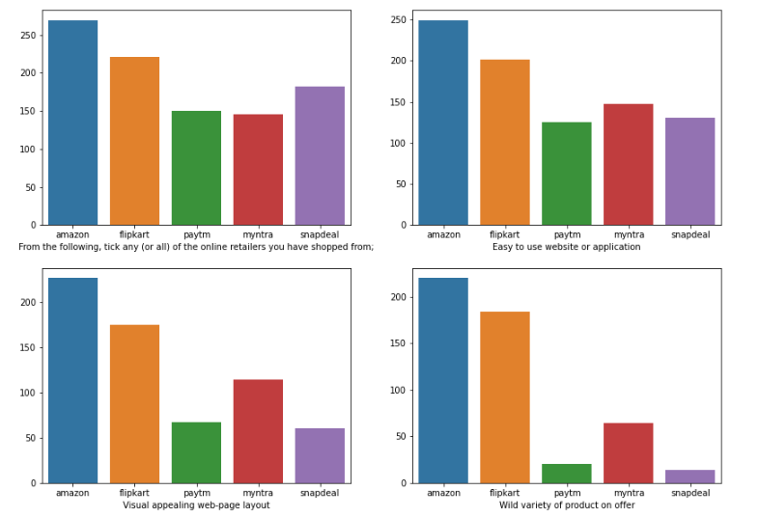
Now let’s analyze customer's feedback for different e-commerce websites on various parameters. The e-commerce websites are amazon, flipkart, myntra, snapdeal and paytm.

Slide 23
Observations: 1. All the respondents have made purchases from amazon.in. 2. Out of 269 more than 200 respondents have shopped from flipkart. The numbers for snapdeal, paytm and myntra are below 200. 3. Amazon performs best in terms of ease to use, visual appeal and product variety followed by flipkart.

Slide 24
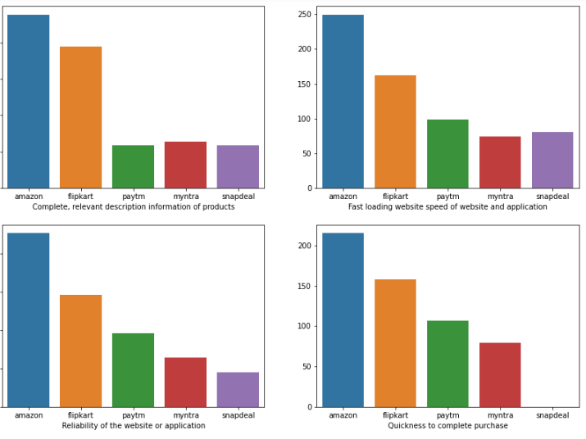
Observations:
Amazon performs best in terms of relevant product information, website loading speed, reliability, and quickness to complete purchase.
Flipkart seems to be the second choice for these above parameters.
The response for paytm, myntra and snapdeal seems to be quite low as compared to amazon.
snapdeal has zero respondents in ‘quickness to complete purchase’ criteria.

Slide 25
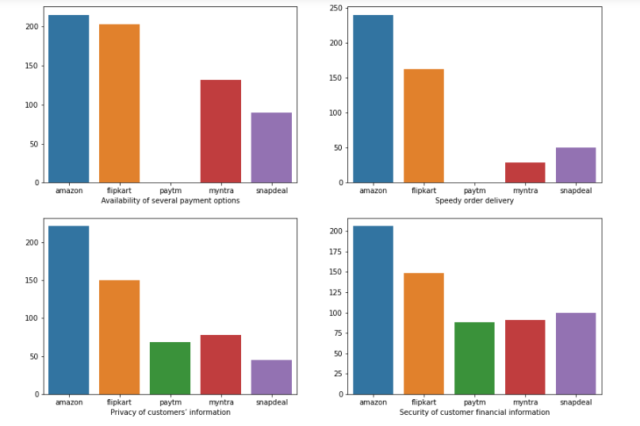
Observations:
Amazon performs best in terms of payment options, speedy delivery, privacy of customer's info and security of financial info.
Flipkart seems to be the second choice for these above parameters.
Paytm performs poorly in payments options and speedy delivery criteria.
The response for paytm, myntra and snapdeal seems to be quite low as compared to amazon.

Slide 26
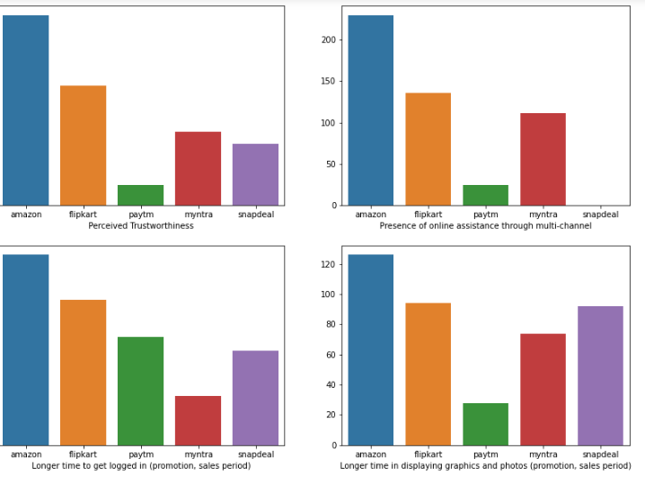
Observations:
Amazon performs best in terms of trustworthiness and online assistance. Flipkart seems to be the second choice.
Paytm performs poorly in trustworthiness and also online assistance.
Snapdeal performs poorly in online assistance criteria.
During promotion or sales period, it takes longer time in amazon to login and display graphics/photos.

Slide 27
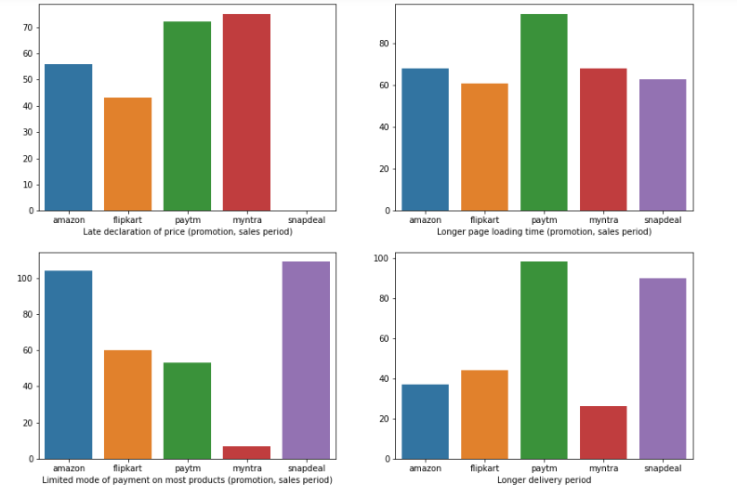
Observations:
During promotion or sales period, myntra and paytm declares price lately.
During promotion or sales period, paytm takes longer time in page loading. We have a fairly mixed response in this criteria.
During promotion or sales period, snapdeal and amazon have limited mode of payments for most products. Myntra performs well in this.
Paytm and snapdeal have longer delivery period.

Slide 28
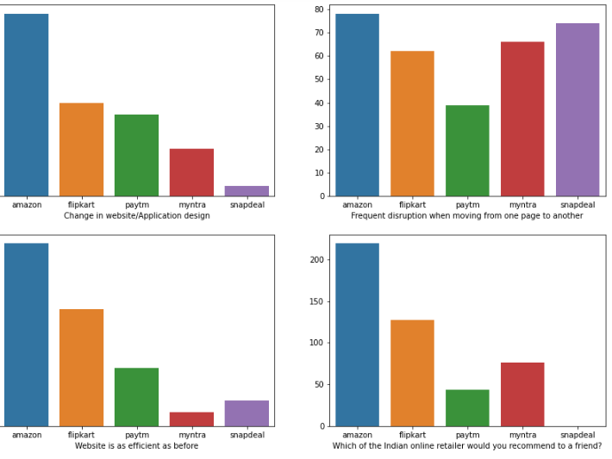
Observations:
Majority of respondents believe that a change in website/application design is needed in amazon.
There are frequent disruptions when moving from one page to another in all of them. Paytm perfoms best in this criteria.
Majority of respondents believe that amazon website is as efficient as before.
Amazon is most likely to be recommended to others by our respondents followed by flipkart, myntra and paytm.
None of the respondents is likely to recommend snapdeal to any of their friends.

Slide 29
Till now we analyzed the data distribution in various columns. Now let us see some plots which shows the relation among various columns.

Slide 30
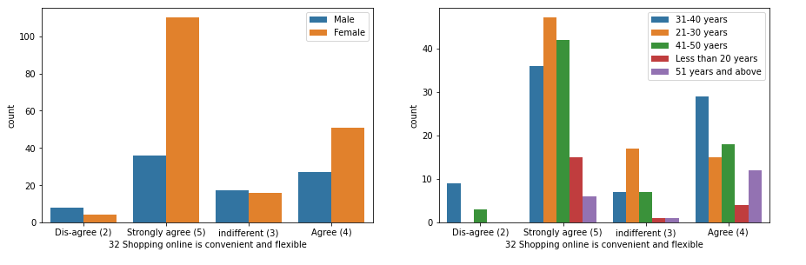
Analyzing the responses for ‘Shopping online is convenient and flexible’ column with respect to other columns. 1. We saw the pie-plot for the overall response on 'Shopping online is convenient and flexible' statement. 2. 224 people out of 269 agree or strongly-agree that shopping online is convenient and flexible. 3. Let's see the plots with respect to gender and age.
Observations:
Out of the people who strongly-agree or agree that shopping online is convenient and flexible, majority are female.

Slide 31
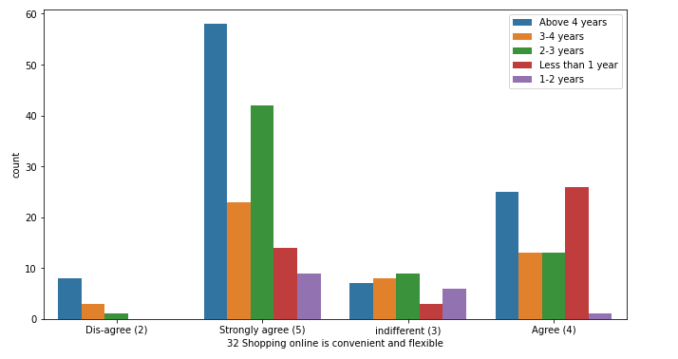
Observations:
Out of the people who strongly-agree that shopping online is convenient and flexible, majority have been shopping online for more than 4 years.

Slide 32
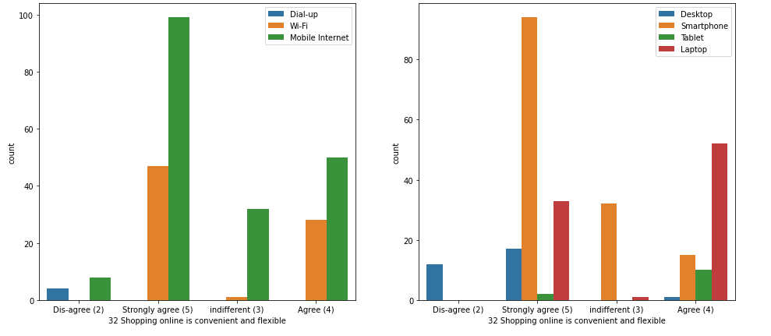
Observations:
Out of the people who strongly-agree or agree that shopping online is convenient and flexible, majority are mobile internet users followed by wi-fi users.
They mainly use smart-phone and laptop.

Slide 33
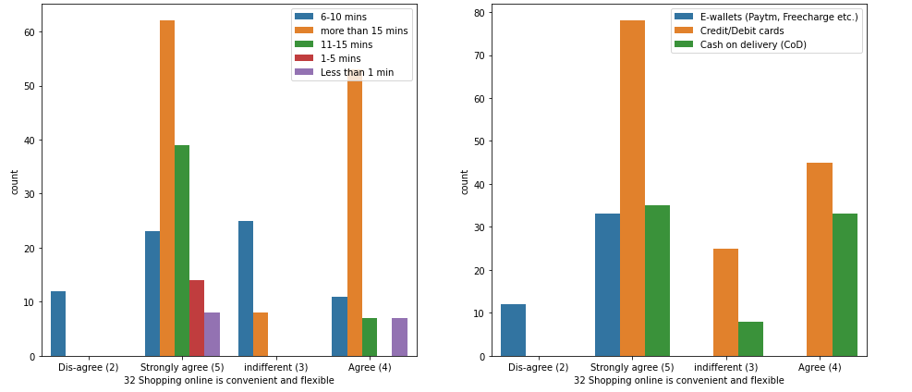
Observations:
Out of the people who strongly-agree or agree that shopping online is convenient and flexible, a high majority of people spend at least 11 minutes before purchasing
They mainly prefer credit/debit cards for payment option followed by cash on delivery.

Slide 34
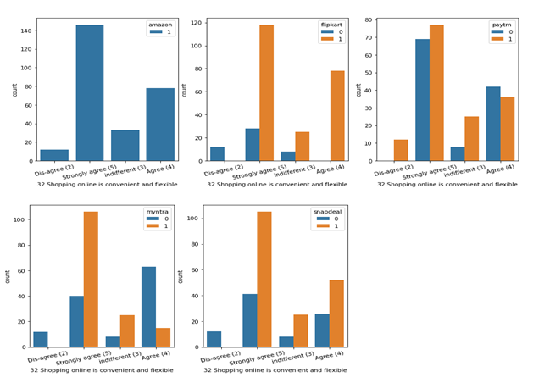
Observations:
All the respondents have shopping experience from amazon.
Out of the 224 people, a very high majority(around 200) have shopping experience from flipkart.( 224 people agree or strongly agree that shopping online is beneficial )
Out of the 224 people, around half the people have shopping experience from paytm.
Out of the 224 people, around 130 people have shopping experience with myntra and around 150 with snapdeal.

Slide 35
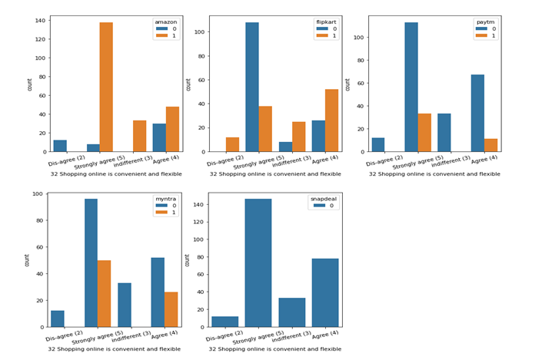
Observations:
Out of the 224 people who strongly-agree or agree that shopping online is convenient and flexible, around 180 people recommends amazon to a friend.
In case of flipkart, out of those 224 people, around 100 recommend it to friends.
In case of myntra, out of those 224 people, around 80 recommend it to friends.
In case of paytm, less than 50.
It seems that no one is likely to recommend snapdeal to their friends.

Slide 36
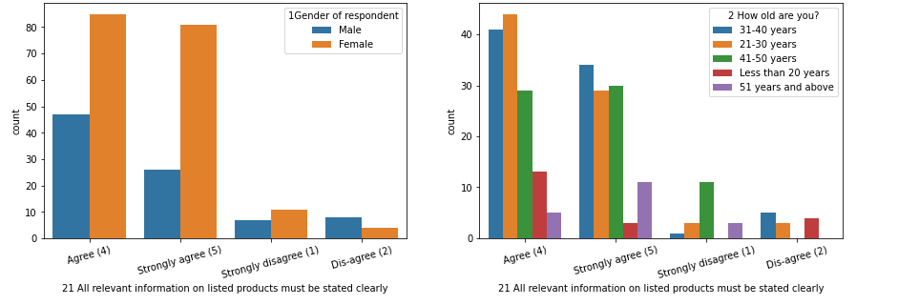
Analyzing the responses for ‘All relevant information on listed products must be stated clearly’ column with respect to other columns. 1. We saw the pie-plot for the overall response on 'All relevant information on listed products must be stated clearly' statement. 2. 239 people out of 269 agree or strongly-agree that shopping online is convenient and flexible. 3. Let's see the plots with respect to gender and age.
Observations:
Out of the people who strongly-agree or agree that all relevant information on listed products must be stated clearly, majority are women.

Slide 37
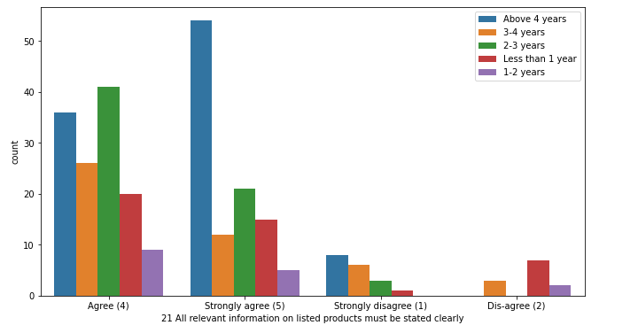
Observations:
Out of the people who strongly-agree or agree that all relevant information on listed products must be stated clearly, a high majority have been shopping online for at least 2 years.

Slide 38
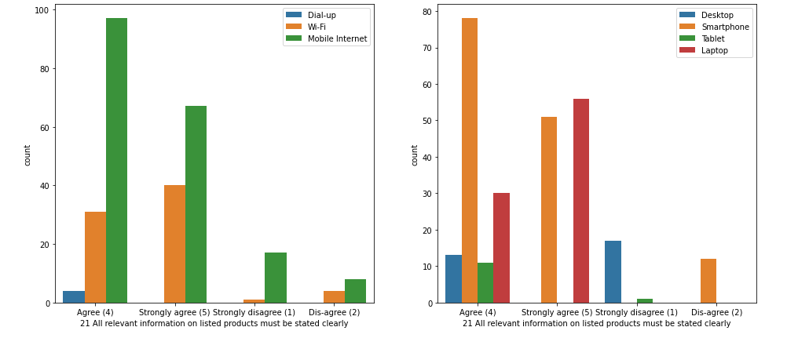
Observations:
Out of the people who strongly-agree or agree that all relevant information on listed products must be stated clearly, majority are mobile internet users followed by Wi-Fi users. They mainly use smart-phone and laptop.

Slide 39
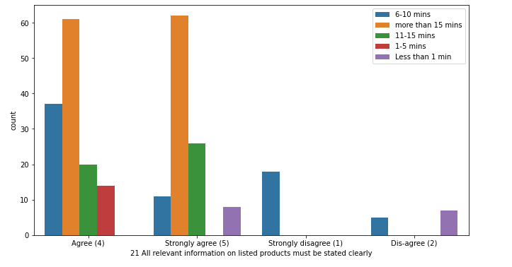
Observations:
Out of the people who strongly-agree or agree that all relevant information on listed products must be stated clearly, majority of people spend more than 15 minutes before making a purchase.

Slide 40
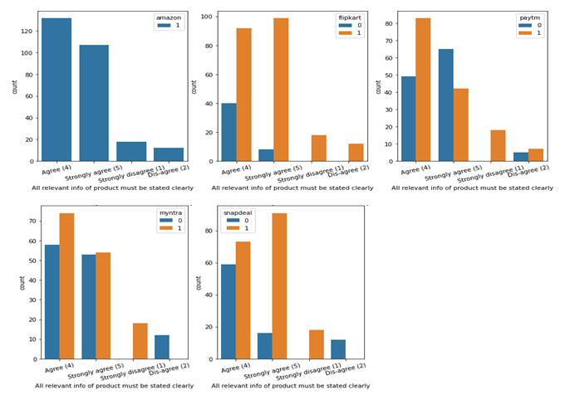
Observations:
All the respondents have shopping experience from amazon.
Out of the 239 people, a high majority(around 190) have shopping experience from flipkart. (239 people agree or strongly agree that all relevant info of product must be stated clearly)
Out of the 239 people, around half the people have shopping experience from paytm.
Out of the 239 people, around 130 people have shopping experience with myntra and around 160 with snapdeal.

Slide 41
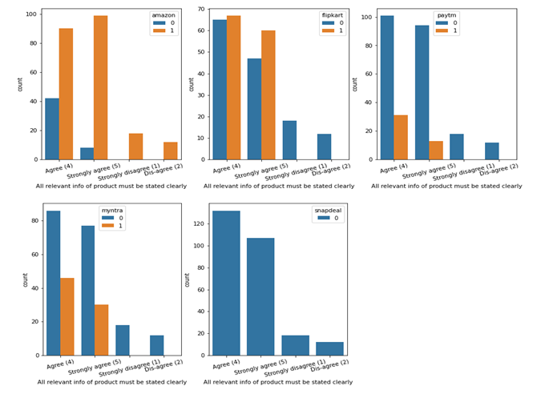
Observations:
Out of the 239 people who strongly-agree or agree that all relevant info of product must be stated clearly, around 190 people recommends amazon to a friend.
In case of flipkart, out of those 239 people, around 125 recommend it to friends.
In case of myntra, out of those 239 people, around 80 recommend it to friends.
In case of paytm, less than 50. And in case of snapdeal no one is likely to recommend it to their friends.

Slide 42
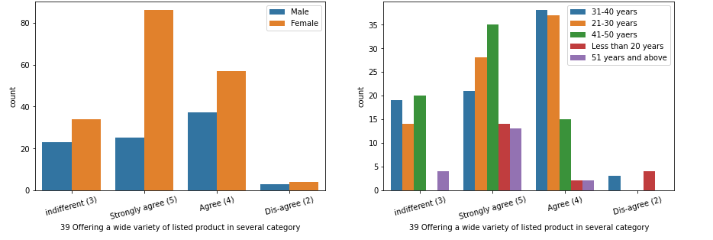
Analyzing the responses for ‘Offering a wide variety of listed product in several category’ column with respect to other columns. 1. We saw the pie-plot for the overall response on 'Offering a wide variety of listed product in several category' statement. 2. 205 people out of 269 agree or strongly-agree that e-retailer should offer a wide variety of listed product in several category. 3. Let's see the plots with respect to gender and age.
Observations:
Out of the people who strongly-agree or agree that e-retailer should offer a wide variety of listed product in several category, majority are female.

Slide 43
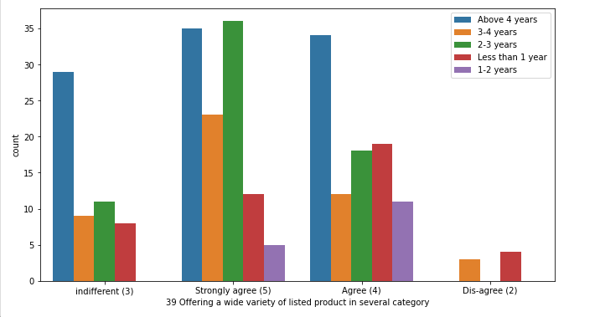
Observations:
Out of the people who strongly-agree or agree that e-retailer should offer a wide variety of listed product in several category, a high majority have been shopping online for atleast 2 years.

Slide 44
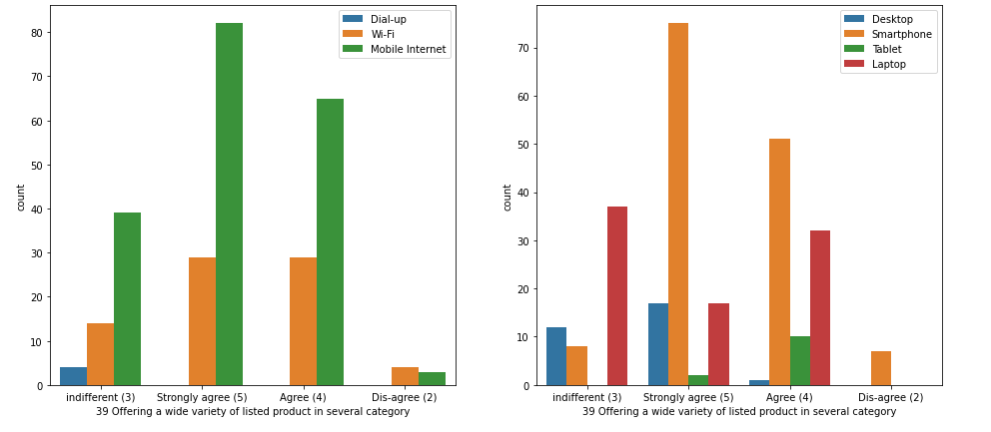
Observations:
Out of the people who strongly-agree or agree that e-retailer should offer a wide variety of listed product in several category, majority are mobile internet users followed by wifi users. They mainly use smartphone and laptop.

Slide 45
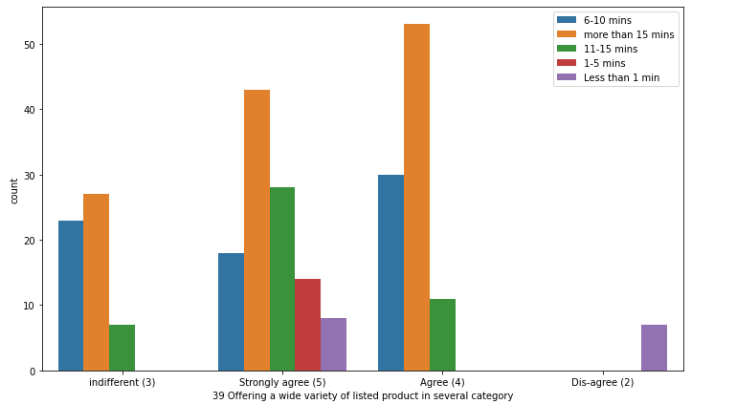
Observations:
Out of the people who strongly-agree or agree that e-retailer should offer a wide variety of listed product in several category, majority of people spend more than 15 minutes before making a purchase.

Slide 46
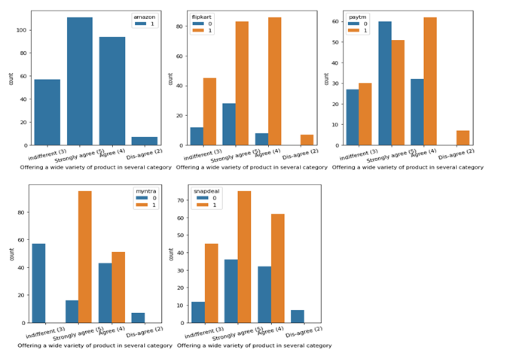
Observations:
All the respondents have shopping experience from amazon.
Out of the 205 people, a high majority(around 170) have shopping experience from flipkart.(205 people agree or strongly agree that e-retailer should offer a wide variety of listed product in several category)
Out of the 205 people,around half the people have shopping experience from paytm.
Out of the 205 people, around 150 people have shopping experience with myntra and around 130 with snapdeal.

Slide 47
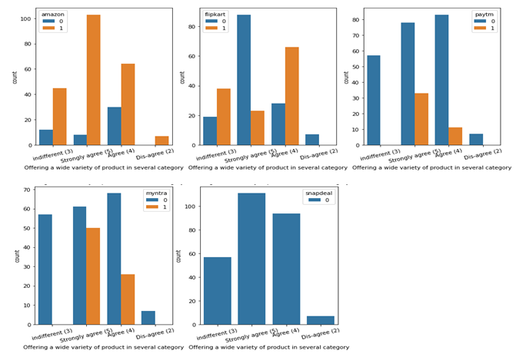
Observations:
Out of the 205 people who strongly-agree or agree that e-retailer should offer a wide variety of listed product in several category, around 165 people recommends amazon to a friend. A majority of people with indifferent view also likely to recmmend amazon.
In case of flipkart, out of those 205 people, around 100 people recommend it to friends.
In case of myntra, out of those 205 people, around 75 recommend it to friends.
In case of paytm, less than 50. And in case of snapdeal no one is likely to recommend it to their friends.

Slide 48
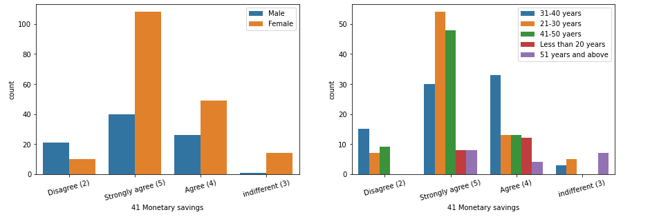
Analyzing the responses for ‘Monetary savings’ column with respect to other columns. 1. We saw the pie-plot for the overall response on 'Monetary savings' statement. 2. 223 people out of 269 agree or strongly-agree that online shopping leads to monetary savings. 3. Let's see the plots with respect to gender and age.
Observations:
Out of the people who strongly-agree or agree that online shopping leads to monetary savings, majority are female.

Slide 49
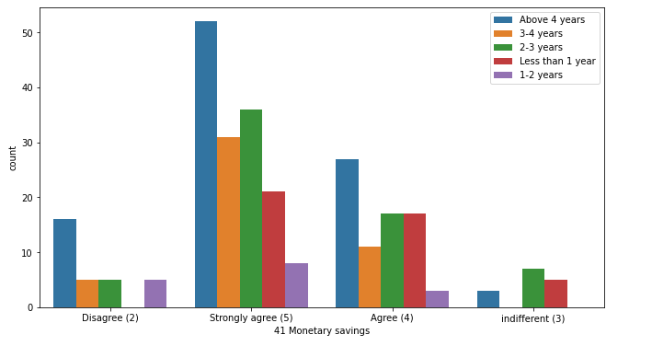
Observations:
Out of the people who strongly-agree or agree that online shopping leads to monetary savings, a high majority have been shopping online for at least 2 years.

Slide 50
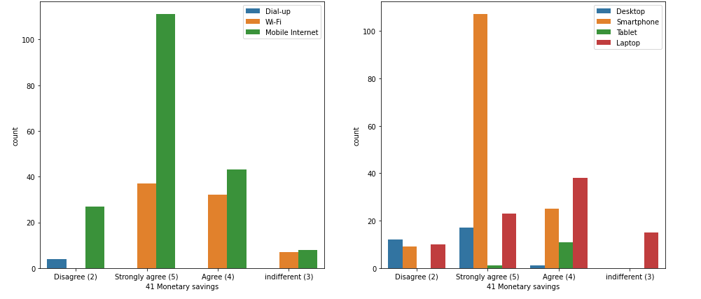
Observations:
Out of the people who strongly-agree or agree online shopping leads to monetary savings, majority are mobile internet users followed by wifi users. They mainly use smartphone and laptop.

Slide 51
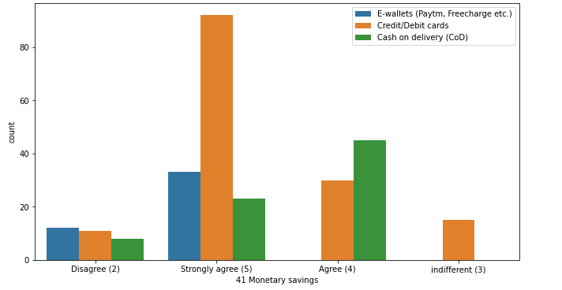
Observations:
Out of the 223 people who strongly-agree or agree that online shopping leads to monetary savings, around 130 prefer credit/debit cards.
Around 70 prefer cash on delivery and less than 50 prefer e-wallets.

Slide 52
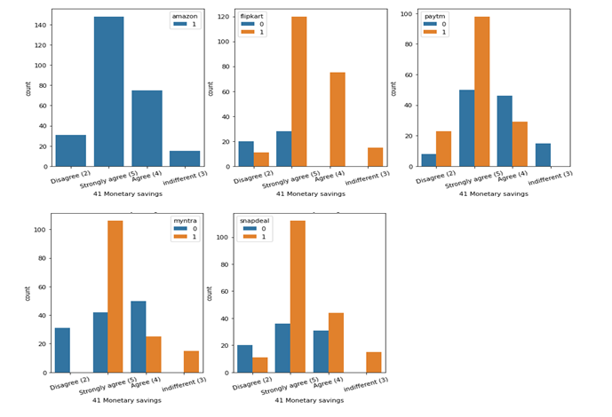
Observations:
All the respondents have shopping experience from amazon.
Out of the 223 people, a high majority(around 190) have shopping experience from flipkart.(223 people agree or strongly agree that online shopping leads to monetary savings)
Out of the 223 people,around 130 people have shopping experience from paytm.
Out of the 223 people, around 130 people have shopping experience with myntra and around 150 with snapdeal.

Slide 53
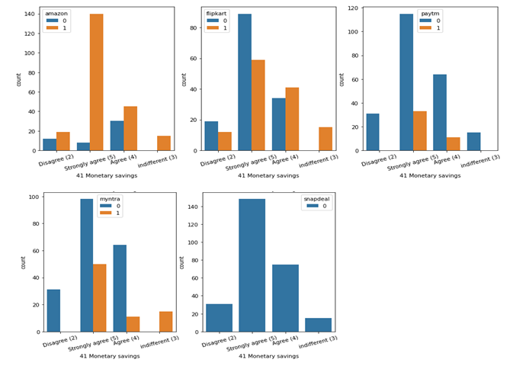
Observations:
Out of the 223 people who strongly-agree or agree that online shopping leads to monetary savings, around 180 people recommends amazon to a friend.
In case of flipkart, out of those 223 people, around 100 people recommend it to friends.
In case of myntra, out of those 205 people, around 60 recommend it to friends.
In case of paytm, less than 50. And in case of snapdeal no one is likely to recommend it to their friends.

Slide 54
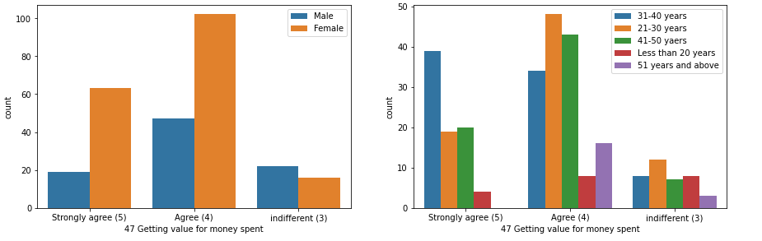
Analyzing the responses for ‘Getting value for money spent’ column with respect to other columns. 1. We saw the pie-plot for the overall response on 'Getting value for money spent' statement. 2. 231 people out of 269 agree or strongly-agree that online shopping helps them get value for money spent. 3. Let's see the plots with respect to gender and age.
Observations:
Out of the people who strongly-agree or agree that online shopping helps them get value for money spent, majority are female.

Slide 55
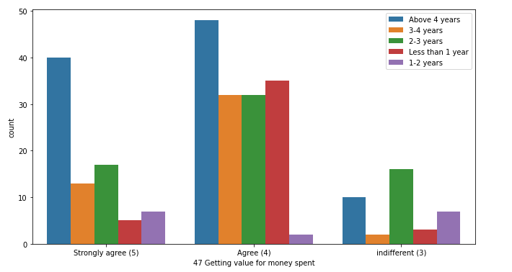
Observations:
Out of the people who strongly-agree or agree that online shopping helps them get value for money spent, a high majority have been shopping online for atleast 2 years.

Slide 56
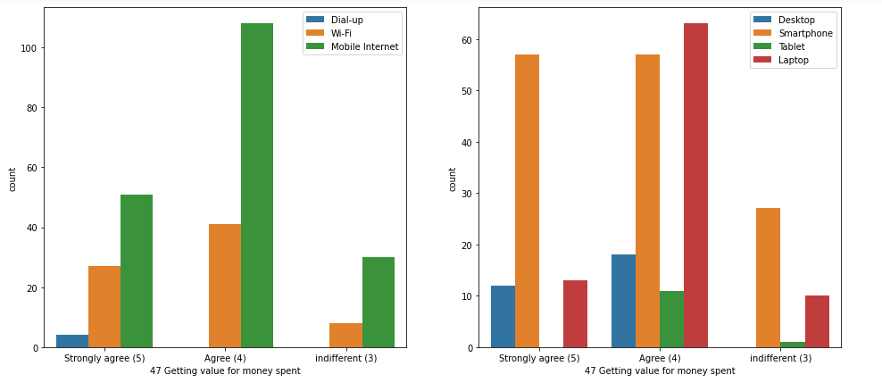
Observations:
Out of the people who strongly-agree or agree online shopping helps them get value for money spent, majority are mobile internet users followed by wi-fi users. They mainly use smart-phone and laptop.

Slide 57
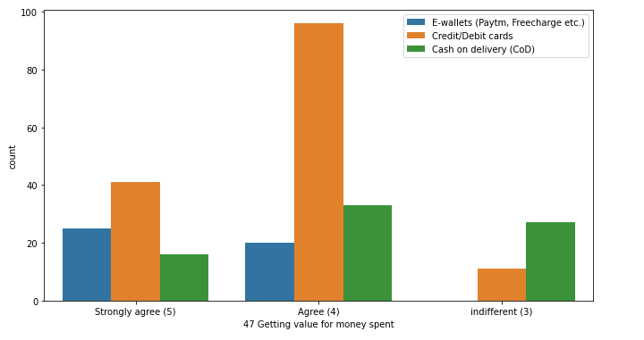
Observations:
Out of the 231 people who strongly-agree or agree that online shopping helps them get value for money spent, around 135 prefer credit/debit cards.
Around 50 prefer cash on delivery and less than 50 prefer e-wallets.

Slide 58

Observations:
All the respondents have shopping experience from amazon.
Out of the 231 people, a high majority(around 180) have shopping experience from flipkart.(231 people agree or strongly agree that online shopping helps them get value for money spent)
Out of the 231 people,around 130 people have shopping experience from paytm.
Out of the 231 people, around 130 people have shopping experience with myntra and around 150 with snapdeal.

Slide 59

Observations:
Out of the 231 people who strongly-agree or agree that online shopping helps them get value for money spent, around 180 people recommends amazon to a friend.
In case of flipkart, out of those 231 people, around 125 people recommend it to friends.
In case of myntra, out of those 231 people, around 70 recommend it to friends.
In case of paytm, less than 50.
It seems that no one is likely to recommend snapdeal to their friends.

Slide 60
CONCLUSION Key Findings: 1. From the various visualizations and corresponding observations it can be said that ‘amazon.in’ is the most trusted and used e-commerce website followed by ‘flipkart.com’. 2. Since none of the customers is likely to recommend ‘snapdeal.com’ to their friends hence it can be said that ‘snapdeal.com’ is the least trusted website among the five we have analyzed. 3. More than 80% of the customers consider that online shopping is convenient and flexible, helps them in saving money, and also get value out of the money they spend. 4. Customer satisfaction depends on a lot of factors which includes quality information, quality website/application, net benefit, trust, privacy, and return policy. 5. More than half the customers enjoy shopping online and it also gives them a sense of adventure. Limitation: This is a very small dataset of only 269 entries. The results or findings cannot be generalized.

